Slide 1

DriverPass System Analysis
Daniel Sullivan

Slide 2

System Requirements
Functional: Students can register online or through the office, log in from any device, purchase a training package, schedule or cancel a driving lesson online or by calling, take online practice tests, and reset their password. The secretary can book and manage appointments on behalf of customers. The IT officer can manage all accounts, reset passwords, and revoke access. Liam can generate and download activity reports in a format compatible with Excel. The system automatically receives updated content from the DMV.
Nonfunctional: The system must be accessible from any computer or mobile device via a web browser. It must be available at least 99.9% of the time. The cloud provider handles all backup and security maintenance so your team does not need to manage it. All reservation actions are logged with user attribution so accountability can be traced. All user data and payment information is encrypted and protected.
Notes:
This slide outlines the requirements that guided our entire design. Starting with what the system must be able to do: students need to be able to create their account, log in from any device, pick a training package, schedule and manage their own driving appointments, and take practice tests online. You mentioned that appointments can also be handled by your secretary over the phone or in person, so the system supports that path as well. Your IT officer, Ian, needs to be able to get into any account to handle password resets and to shut off access if someone leaves the company. And you personally, Liam, need to be able to pull reports and download data you can work with at home. The DMV connection means that your practice test content stays current automatically, without anyone on your team having to manually update it. On the performance and reliability side, the system is designed to be accessible from any computer or smartphone, which was one of the first things you mentioned wanting. The cloud hosting means that backups and security are the provider’s responsibility, which Ian specifically asked for. And the activity logging system means that every reservation action is tied to a specific user, so if something goes wrong you can always pull a report and find out exactly who did what.

Slide 3
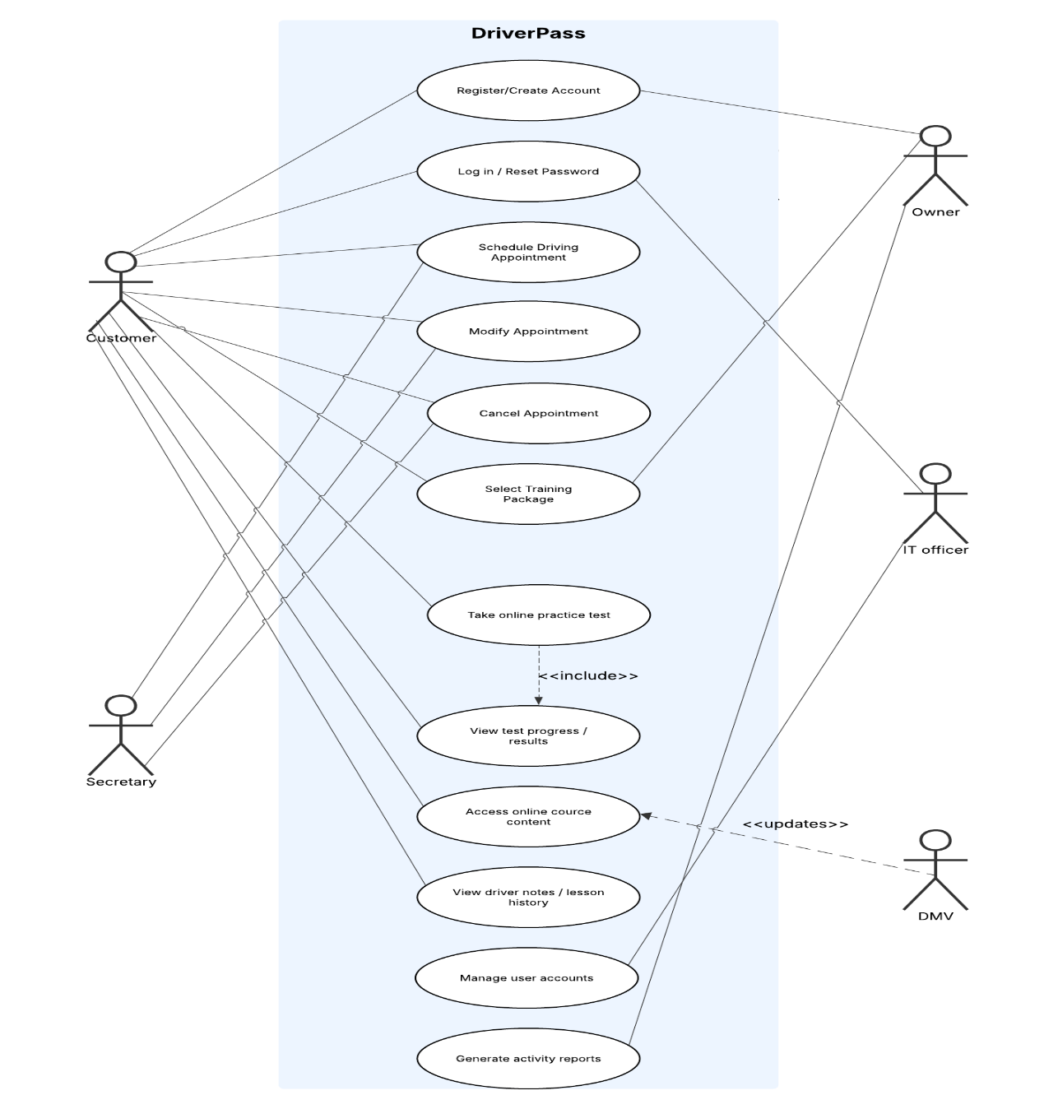
Use Case Diagram
Notes:
This diagram shows every person or outside system that interacts with DriverPass, and every action they can take. There are five groups involved. Students are the primary users. They create their account, log in, choose a package, schedule and manage their driving appointments, and take practice tests. The secretary represents your office staff. When a customer calls or comes in to book an appointment, the secretary handles that in the system on their behalf. This was something you mentioned specifically, Liam, and we made sure to reflect it here. Your IT officer, Ian, can access any account in the system, reset passwords, and shut off access for anyone who should no longer have it. You, as the owner, can pull reports and download data to review offline. And finally, the DMV is shown as an outside connection. When they update their rules or sample questions, that information flows automatically into our system and refreshes the practice test content. Every action shown in this diagram maps directly to something one of you described as a need during our first meeting. Nothing is included that you did not ask for, and nothing you asked for has been left out.

Slide 4
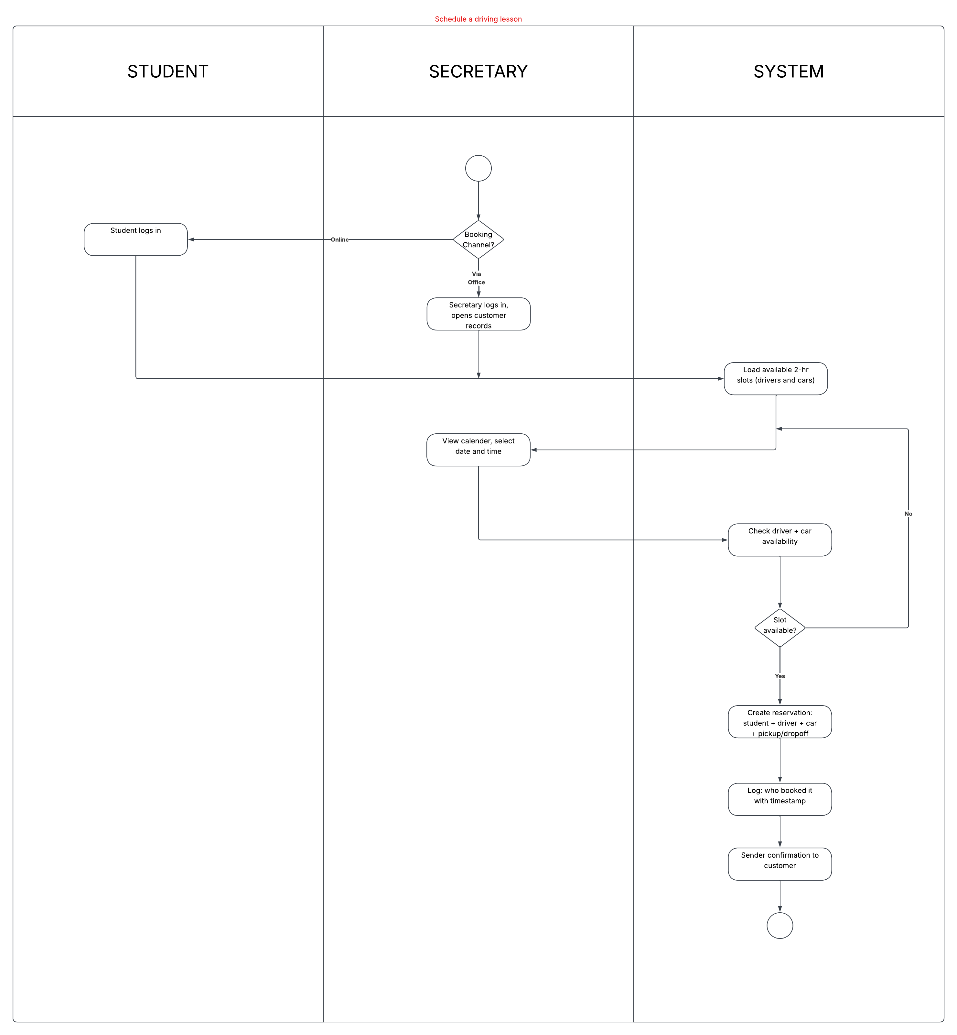
Activity Diagram
Notes:
This diagram walks through exactly what happens when someone wants to book a driving lesson. I want to highlight something important here. You told us, Liam, that customers should be able to book online through their own account, but also by calling or stopping by the office. This diagram reflects both of those paths. At the very start, there is a choice point: is the customer booking online themselves, or is your secretary handling it on their behalf? Either way, the next steps are the same. The system displays the available dates and times based on what is actually open, taking into account which drivers and which of your ten cars are already committed. This matters because you mentioned that the system needs to track which specific customer is paired with which driver and which car for each lesson. Once someone selects a time, the system verifies the slot is still available. If it is not, they are sent back to choose again. If it is, the reservation is saved, and a confirmation goes out to the customer. Every session is set to two hours in length, exactly as you described. And every booking is recorded with the name of the person who made it, so if something goes wrong with an appointment, you can always pull that record and see exactly what happened and who was responsible.

Slide 5
Security
Each user has a specific role that controls exactly what they can see and do. Students access only their own account. The secretary manages customer appointments. The IT officer has full account access including password resets and the ability to revoke access entirely. The owner can access all reports and downloadable data. Passwords are stored in a protected format that cannot be read, even internally. All data transmitted between a user and the system is encrypted so it cannot be intercepted. Sensitive stored data, including customer payment information collected at registration, is encrypted at rest. Every reservation action is logged with a timestamp and the identity of the user who performed it, supporting your requirement to trace accountability. The system can lock accounts after repeated failed login attempts and supports self-service password reset for customers online.
Notes:
Security shaped our design from the start, because several things you and Ian described in our first meeting have direct security implications. Ian, you mentioned needing full access over all accounts so you can reset passwords or block someone if they leave the company. That is built directly into the system. Every user is assigned a role, and that role determines exactly what they can see and do. A student cannot get into the secretary’s tools. The secretary cannot access Ian’s administrative functions. And Ian can get into any account he needs to. Passwords are never stored in a readable form. Even if someone gained unauthorized access to our database, the passwords inside it could not be used. All information traveling between a user’s device and the system is protected, so it cannot be read by anyone in between. This applies to your customers’ payment information as well, since you collect credit card numbers, expiration dates, and security codes at registration. That data is encrypted both when it is being transmitted and while it is sitting in the database. You also told us you want to know who made, modified, or canceled every reservation. That is covered by our activity logging, which records the name of the user and the time of every action. You can pull that log as a report whenever you need it. And if a customer forgets their password, they can reset it themselves online without needing to call anyone, which Ian mentioned as a requirement.

Slide 6
System Limitations
The system requires an active internet connection. Data can only be modified online to prevent duplicates, as discussed in our first meeting. Reservations cannot be made or changed offline. The quality and availability of driving lessons depends on how many drivers and cars are registered; the system reflects what is available but cannot create capacity. The self-service package disabling feature allows you to deactivate packages, but adding or removing package types requires a developer. The DMV integration depends on the DMV maintaining a consistent data format; changes on their end may require updates on ours. The system does not include a built-in live chat or phone support tool for customers needing help.
Notes:
I want to be upfront about where the system has boundaries, because understanding these now will help you plan. The most important one came up in our very first conversation. When you said you wanted to access data online and offline, we discussed that any changes to the system need to happen online. The reason is that if someone edits data on one device while disconnected, and someone else edits it on another, the system ends up with two conflicting versions. You agreed that online-only for editing was the right call, so reservations, cancellations, and account changes all require an internet connection. Downloading reports to work on at home in Excel is still fully supported. The second limitation is about lesson availability. The system can only show and book what is actually there. If you have ten cars and ten drivers fully booked on a given day, the system will show no availability, because there is none. Adding more capacity means adding more drivers and cars to the roster, which is a business decision rather than a system one. On packages: we built in the ability for you to disable a package so no new customers can enroll in it. But if you want to add a completely new package type or restructure how packages work, that will require a developer. Sam mentioned this in our first meeting and you agreed it was acceptable for this version. The DMV connection is another area to be aware of. If the DMV changes how they share their data, we may need to update the connection on our end. Finally, the system does not have a built-in tool for customers to chat with your team or get live help. Customers who need support would need to call or email your office directly.

